Slide 1

CHAPTER 7
FUNCTIONS
Copyright © Cengage Learning. All rights reserved.

Slide 2
SECTION 7.4
Cardinality with Applications to Computability
Copyright © Cengage Learning. All rights reserved.

Slide 3
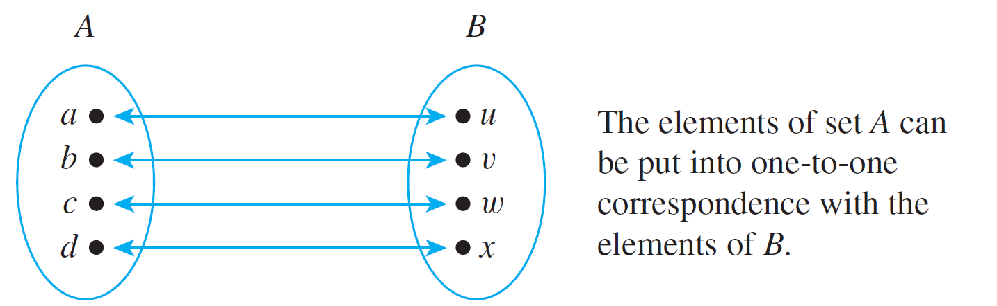
Cardinality with Applications to Computability
We say that two finite sets whose elements can be paired by a one-to-one correspondence have the same size. This is illustrated by the following diagram.

Slide 4
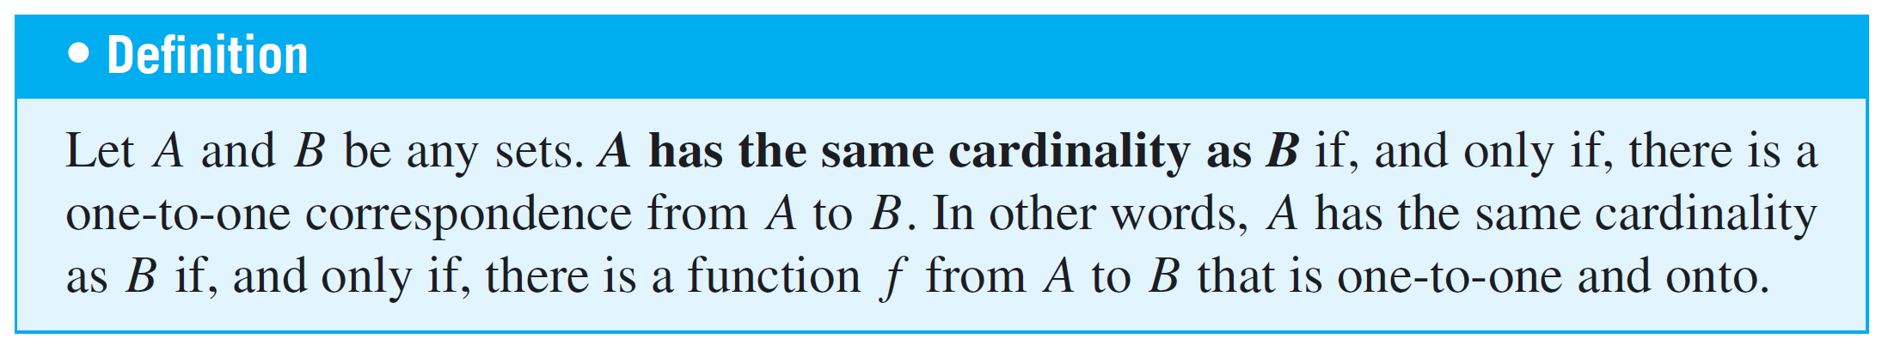
Cardinality with Applications to Computability
Now a finite set is one that has no elements at all or that can be put into one-to-one correspondence with a set of the form {1, 2, . . . , n} for some positive integer n.
By contrast, an infinite set is a nonempty set that cannot be put into one-to-one correspondence with {1, 2, . . . , n} for any positive integer n.

Slide 5
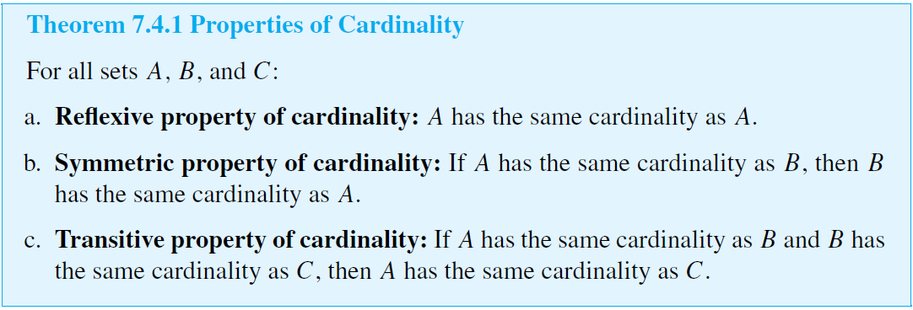
Cardinality with Applications to Computability
The following theorem gives some basic properties of cardinality, most of which follow from statements proved earlier about one-to-one and onto functions.

Slide 6
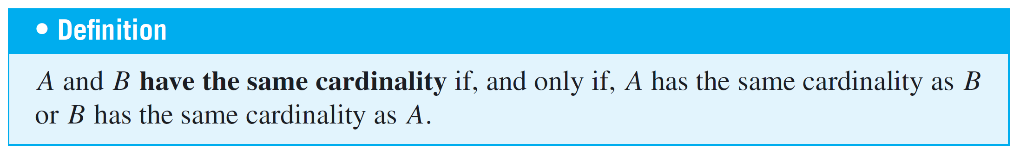
Cardinality with Applications to Computability
Note that Theorem 7.4.1(b) makes it possible to say simply that two sets have the same cardinality instead of always having to say that one set has the same cardinality as another. That is, the following definition can be made.

Slide 7
Cardinality with Applications to Computability
The following example illustrates a very important property of infinite sets—namely, that an infinite set can have the same cardinality as a proper subset of itself.
This property is sometimes taken as the definition of infinite set.
The example shows that even though it may seem reasonable to say that there are twice as many integers as there are even integers, the elements of the two sets can be matched up exactly, and so, according to the definition, the two sets have the same cardinality.

Slide 8


Example 1 – An Infinite Set and a Proper Subset Can Have the Same Cardinality
Let 2Z be the set of all even integers. Prove that 2Z and Z have the same cardinality.
Solution:
Consider the function H from Z to 2Z defined as follows:

Slide 9
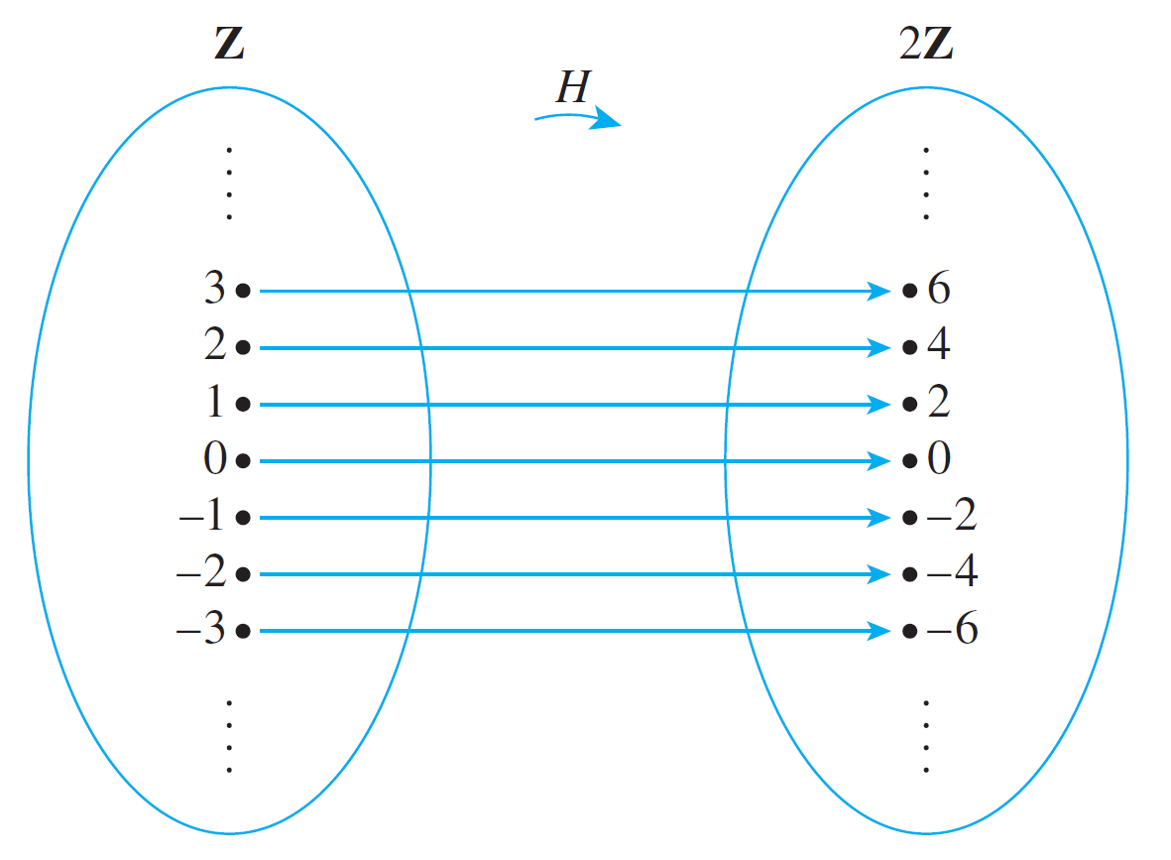
Example 1 – Solution
cont’d
A (partial) arrow diagram for H is shown below.

Slide 10
Example 1 – Solution
cont’d
To show that H is one-to-one, suppose H(n₁) = H(n₂) for some integers n₁ and n₂.
Then 2n₁ = 2n₂ by definition of H, and dividing both sides by 2 gives n₁ = n₂. Hence h is one-to-one.
To show that H is onto, suppose m is any element of 2Z. Then m is an even integer, and so m = 2k for some integer k.
It follows that H(k) = 2k = m. Thus there exists k in Z with H(k) = m, and hence H is onto.
Therefore, by definition of cardinality, Z and 2Z have the same cardinality.

Slide 11
Countable Sets

Slide 12
Countable Sets
The set Z⁺ of counting numbers {1, 2, 3, 4, . . .} is, in a sense, the most basic of all infinite sets.
A set A having the same cardinality as this set is called countably infinite.
The reason is that the one-to-one correspondence between the two sets can be used to “count” the elements of A: If F is a one-to-one and onto function from Z⁺ to A, then F(1) can be designated as the first element of A, F(2) as the second element of A, F(3) as the third element of A, and so forth.

Slide 13
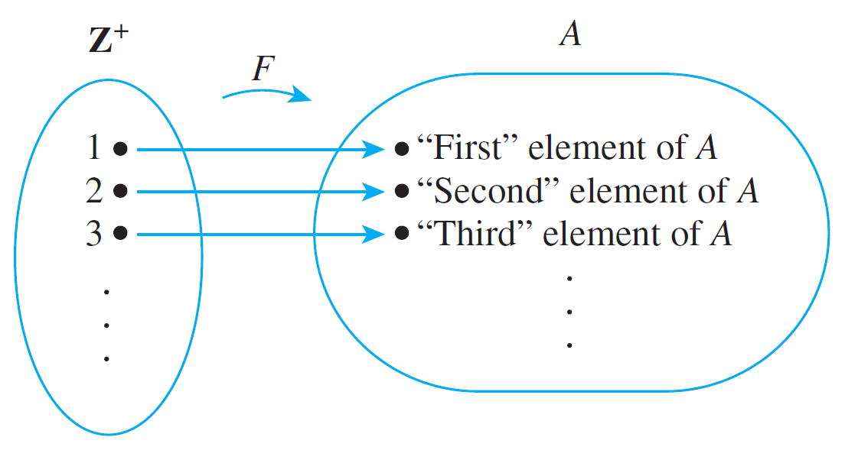
Countable Sets
This is illustrated graphically in Figure 7.4.1.
Because F is one-to-one, no element is ever counted twice, and because it is onto, every element of A is counted eventually.
“Counting” a Countably Infinite Set
Figure 7.4.1

Slide 14
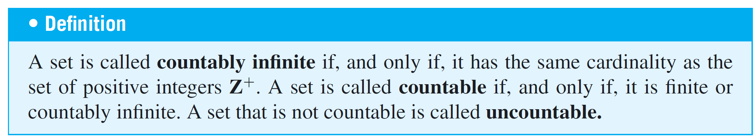
Countable Sets

Slide 15
Example 2 – Countability of Z, the Set of All Integers
Show that the set Z of all integers is countable.
Solution:
The set Z of all integers is certainly not finite, so if it is countable, it must be because it is countably infinite.
To show that Z is countably infinite, find a function from the positive integers Z⁺ to Z that is one-to-one and onto.

Slide 16
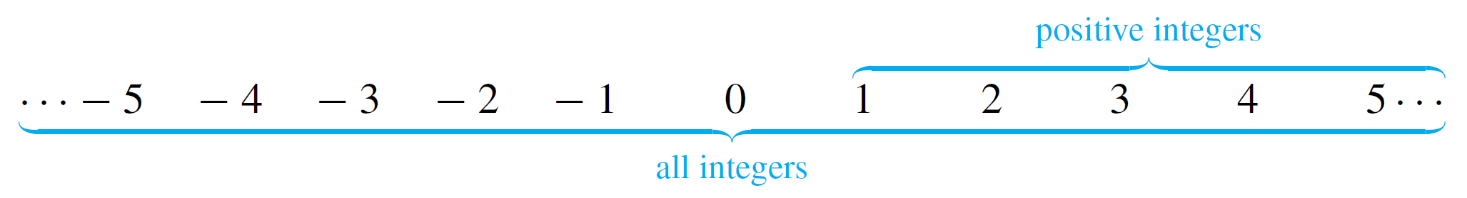
Example 2 – Solution
cont’d
Looked at in one light, this contradicts common sense; judging from the diagram below, there appear to be more than twice as many integers as there are positive integers.
But you were alerted that results in this section might be surprising. Try to think of a way to “count” the set of all integers anyway.

Slide 17
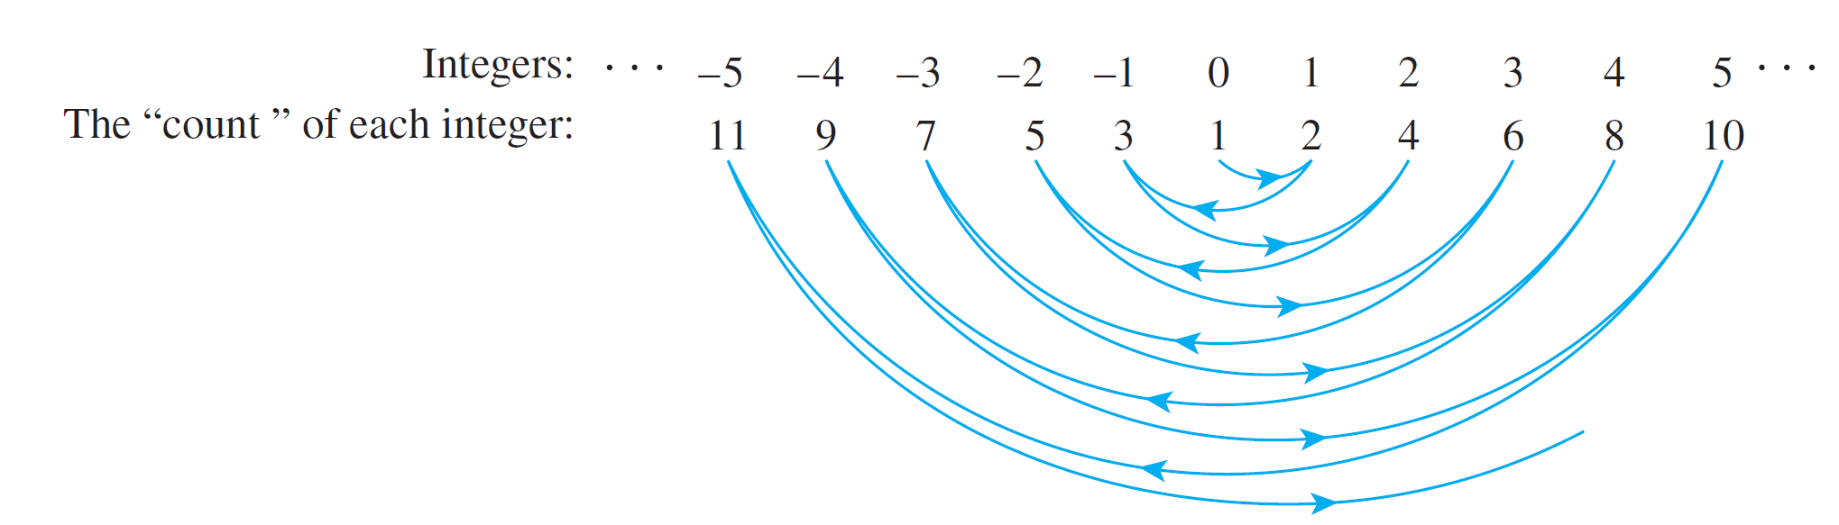
Example 2 – Solution
cont’d
The trick is to start in the middle and work outward systematically. Let the first integer be 0, the second 1, the third –1, the fourth 2, the fifth –2, and so forth as shown in Figure 7.4.2, starting at 0 and swinging outward in
back-and-forth arcs from positive to negative integers and back again, picking up one additional integer at each swing.
“Counting” the Set of All Integers
Figure 7.4.2

Slide 18
Example 2 – Solution
cont’d
It is clear from the diagram that no integer is counted twice (so the function is one-to-one) and every integer is counted eventually (so the function is onto).
Consequently, this diagram defines a function from Z⁺ to Z that is one-to-one and onto. Even though in one sense there seem to be more integers than positive integers, the elements of the two sets can be paired up one for one.
It follows by definition of cardinality that Z⁺ has the same cardinality as Z. Thus Z is countably infinite and hence countable.

Slide 19
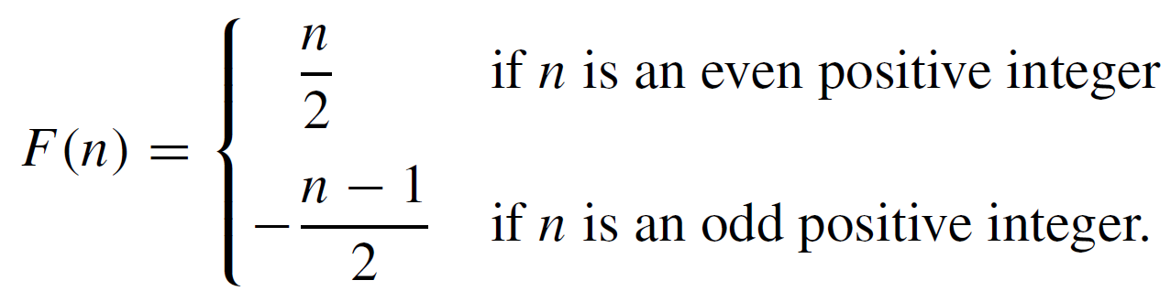
Example 2 – Solution
cont’d
The diagrammatic description of the previous function is acceptable as given. You can check, however, that the function can also be described by the explicit formula

Slide 20
The Search for Larger Infinities:
The Cantor Diagonalization Process

Slide 21
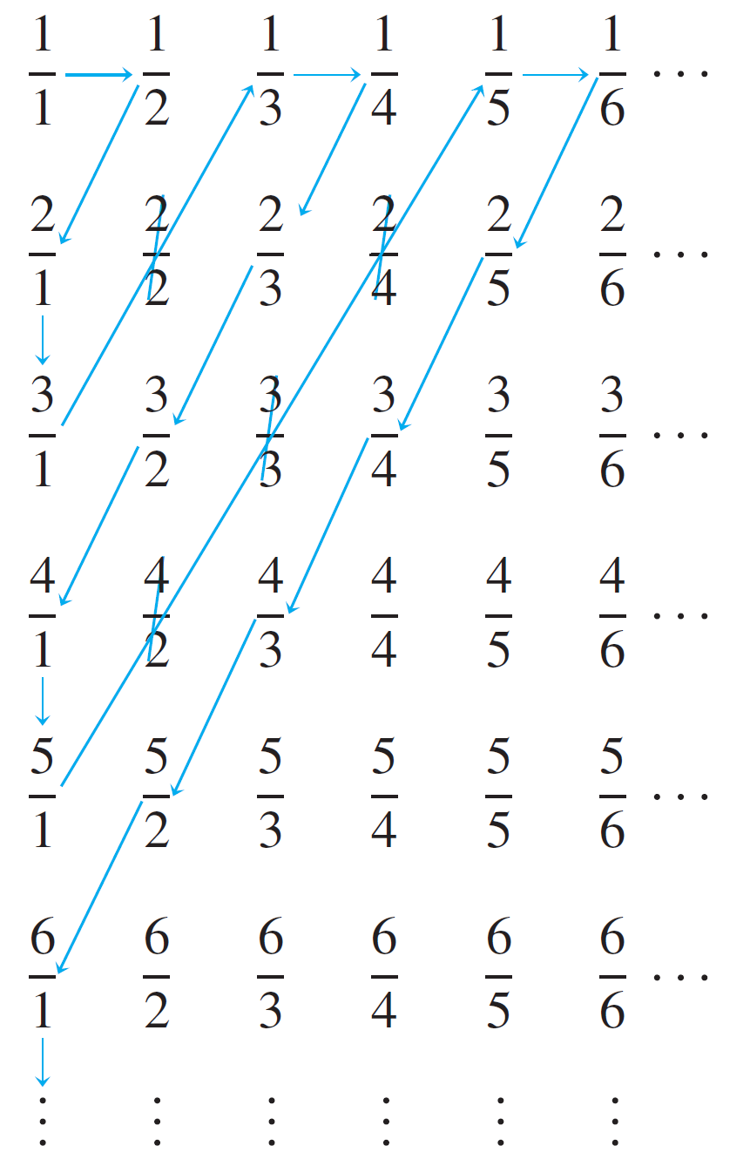
Example 4 – The Set of All Positive Rational Numbers Is Countable
Show that the set Q⁺ of all positive rational numbers is countable.
Solution:
Display the elements of the set Q⁺
of positive rational numbers in a
grid as shown in Figure 7.4.3
Figure 7.4.3

Slide 22



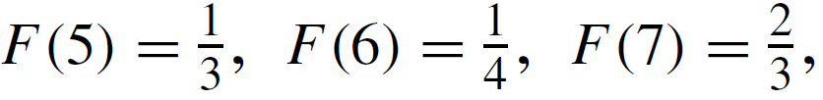


Example 4 – Solution
cont’d
Define a function F from Z⁺ to Q⁺ by starting to count at and following the arrows as indicated, skipping over any number that has already been counted.
To be specific: Set
Then skip since which was counted first.
After that, set
and

Slide 23
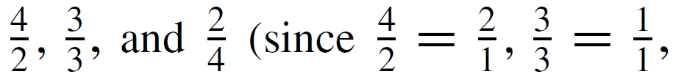

Example 4 – Solution
cont’d
Then skip
Continue in this way, defining F(n) for each positive
integer n.
Note that every positive rational number appears somewhere in the grid, and the counting procedure is set up so that every point in the grid is reached eventually.

Slide 24
Example 4 – Solution
cont’d
Thus the function F is onto. Also, skipping numbers that have already been counted ensures that no number is counted twice.
Thus F is one-to-one. Consequently, F is a function from Z⁺ to Q⁺ that is one-to-one and onto, and so Q⁺ is countably infinite and hence countable.

Slide 25
The Search for Larger Infinities: The Cantor Diagonalization Process
In 1874 the German mathematician Georg Cantor achieved success in the search for a larger infinity by showing that the set of all real numbers is uncountable. His method of proof was somewhat complicated, however.
The uncountability of the set of all real numbers between 0 and 1 using a simpler technique introduced by Cantor in 1891 is called as the Cantor diagonalization process.
Over the intervening years, this technique and variations on it have been used to establish a number of important results in logic and the theory of computation.

Slide 26
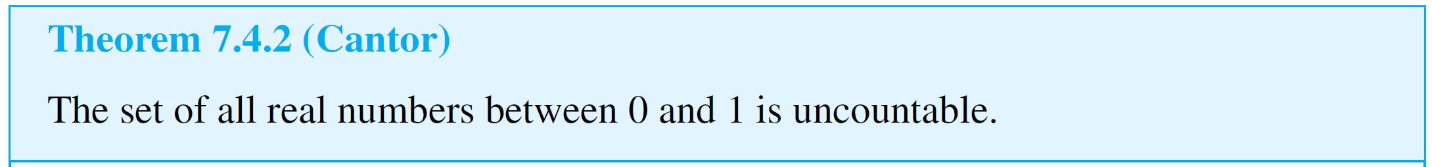
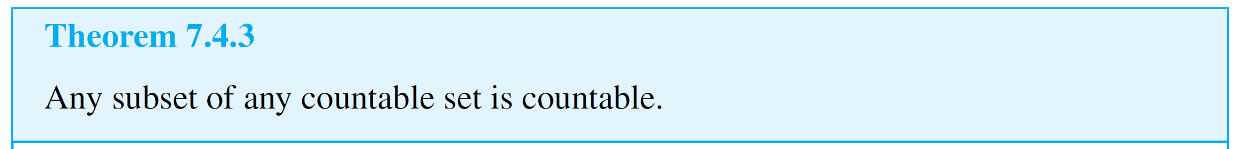
The Search for Larger Infinities: The Cantor Diagonalization Process
Along with demonstrating the existence of an uncountable set, Cantor developed a whole arithmetic theory of infinite sets of various sizes. One of the most basic theorems of the theory states that any subset of a countable set is countable.

Slide 27
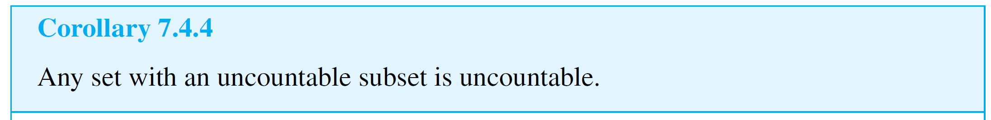
The Search for Larger Infinities: The Cantor Diagonalization Process
An immediate consequence of Theorem 7.4.3 is the following corollary.
Corollary 7.4.4 implies that the set of all real numbers is uncountable because the subset of numbers between 0 and 1 is uncountable. In fact, next Example shows, the set of all real numbers has the same cardinality as the set of all real numbers between 0 and 1!

Slide 28

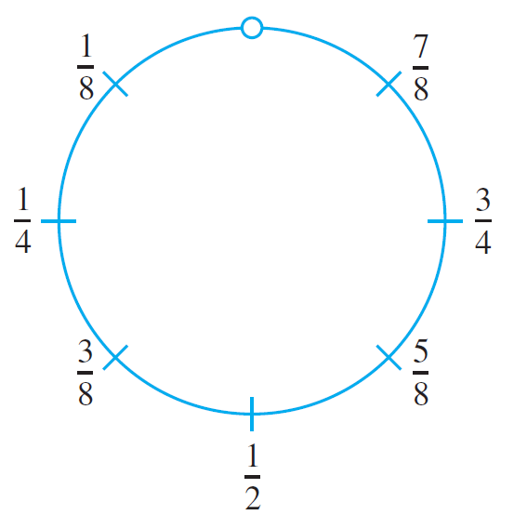
Example 5 – The Cardinality of the Set of All Real Numbers
Show that the set of all real numbers has the same cardinality as the set of real numbers between 0 and 1.
Solution:
Let S be the open interval of real numbers between 0 and 1:
Imagine picking up S and bending it into a
circle as shown in the right side. Since S
does not include either endpoint 0 or 1,
the top-most point of the circle is omitted
from the drawing.

Slide 29
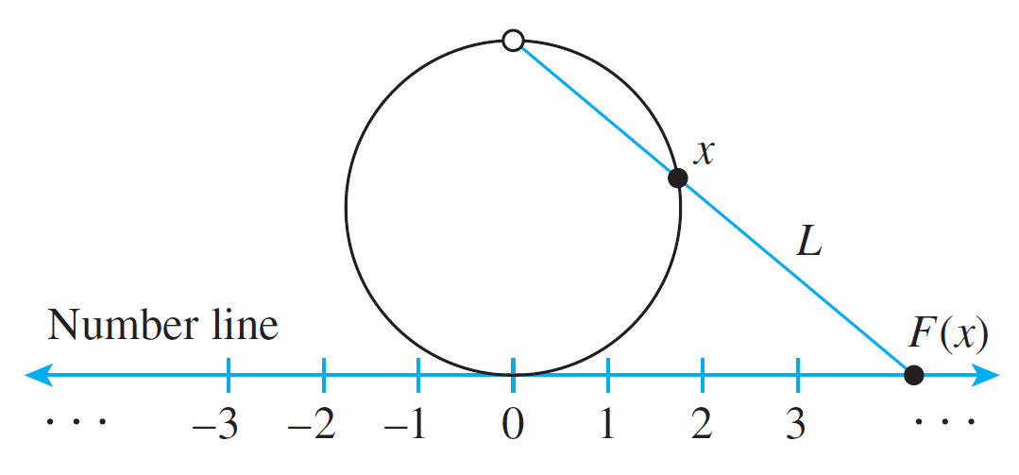
Example 5 – Solution
cont’d
Define a function F: S → R as follows:
Draw a number line and place the interval, S, somewhat enlarged and bent into a circle, tangent to the line above the point 0. This is shown below.

Slide 30
Example 5 – Solution
cont’d
For each point x on the circle representing S, draw a straight line L through the topmost point of the circle and x.
Let F(x) be the point of intersection of L and the number line. (F(x) is called the projection of x onto the number line.)
It is clear from the geometry of the situation that distinct points on the circle go to distinct points on the number line, so F is one-to-one.
In addition, given any point y on the number line, a line can be drawn through y and the top-most point of the circle.

Slide 31
Example 5 – Solution
cont’d
This line must intersect the circle at some point x, and, by definition, y = F(x).
Thus F is onto. Hence F is a one-to-one correspondence from S to R, and so S and R have the same cardinality.

Slide 32
Application: Cardinality and Computability

Slide 33
Application: Cardinality and Computability
Knowledge of the countability and uncountability of certain sets can be used to answer a question of computability. We begin by showing that a certain set is countable.

Slide 34
Example 6 – Countability of the Set of Computer Programs in a Computer Language
Show that the set of all computer programs in a given computer language is countable.
Solution:
This result is a consequence of the fact that any computer program in any language can be regarded as a finite string of symbols in the (finite) alphabet of the language.
Given any computer language, let P be the set of all computer programs in the language. Either P is finite or P is infinite. If P is finite, then P is countable and we are done.

Slide 35
Example 6 – Solution
cont’d
If P is infinite, set up a binary code to translate the symbols of the alphabet of the language into strings of 0’s and 1’s. (For instance, either the seven-bit American Standard Code for Information Interchange, known as ASCII, or the eight-bit Extended Binary-Coded Decimal Interchange Code, known as EBCDIC, might be used.)
For each program in P, use the code to translate all the symbols in the program into 0’s and 1’s. Order these strings by length, putting shorter before longer, and order all strings of a given length by regarding each string as a binary number and writing the numbers in ascending order.

Slide 36
Example 6 – Solution
cont’d
Define a function
By construction, F is one-to-one and onto, and so P is countably infinite and hence countable. As a simple example, suppose the following are all the programs in P that translate into bit strings of length less than or equal to 5:

Slide 37



Example 6 – Solution
cont’d
Ordering these by length gives
And ordering those of each given length by the size of the binary number they represent gives

Slide 38
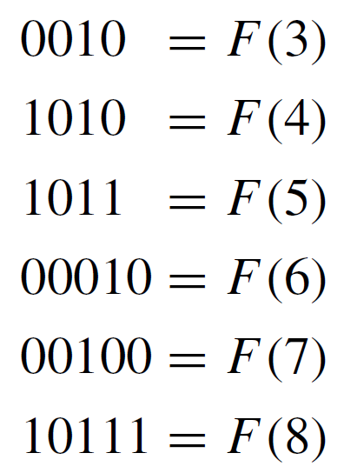
Example 6 – Solution
cont’d
Note that when viewed purely as numbers, ignoring leading zeros, 0010 = 00010.
This shows the necessity of first ordering the strings by length before arranging them in ascending numeric order.

